Slide 1



FIRST REVIEW
Department of Computer Science and Engineering
22CSP72 PROJECT WORK II
Tuberculosis Detection from Chest X-Ray Images Using Deep Learning
Team Number : A22
Team Guide : Dr. K. Venu ASP/CSE
Team Members :
Abinandhana S G (23CSR008)
Anbuselvam N (23CSR018)
Gobika R (23CSR062)

Slide 2
PROBLEM STATEMENT
Tuberculosis remains a major global health challenge requiring early and accurate diagnosis.
Manual chest X-ray interpretation is time-consuming and depends on experienced radiologists.
The existing Enhanced CoAtNet-based TB detection model performs automated classification but analyzes the entire chest X-ray image without explicitly focusing on the lung region.
The existing model uses LIME for explainability, which provides local feature-based explanations but does not generate class-specific activation heatmaps.
Therefore, an improved explainable AI framework integrating lung segmentation, Enhanced CoAtNet, and Grad-CAM is proposed to improve interpretability and provide better diagnostic support.

Slide 3
OBJECTIVES
Develop an automated Tuberculosis (TB) detection system using chest X-ray images.
Integrate the Shenzhen and Montgomery chest X-ray datasets for model development.
Apply image preprocessing techniques such as resizing and CLAHE to enhance image quality.
Perform lung segmentation to extract the lung region and remove irrelevant background information.
Train an Enhanced CoAtNet model for accurate TB classification.
Classify chest X-ray images into Tuberculosis and Normal categories.
Integrate Grad-CAM to provide explainable visualizations of the model's predictions.
Generate a diagnostic report displaying the predicted class, confidence score, and Grad-CAM heatmap.
Support healthcare professionals in the early and reliable diagnosis of Tuberculosis

Slide 4
Parameter | Description
Paper Title | TB-CXRNet: Tuberculosis and Drug-Resistant Tuberculosis Detection Technique Using Chest X-ray Images
Year | 2024
Objective | To develop an automated deep learning framework for detecting Tuberculosis (TB), Non-TB lung infections, Healthy cases, and Drug-Resistant TB from chest X-ray images.
Problem Addressed | Manual diagnosis of TB from chest X-rays is time-consuming, subjective, and requires experienced radiologists. Early detection of drug-resistant TB is also difficult using conventional diagnostic methods.
Dataset Used | QU-MLG-TB dataset containing approximately 40,000 chest X-ray images collected from multiple public and restricted sources. The dataset includes Healthy, Non-TB, TB, MDR-TB, and XDR-TB cases.
Model Used | Proposed TB-CXRNet, a CNN-based deep learning architecture combined with a Multi-Layer Perceptron (MLP) classifier. For drug-resistant TB classification, CheXNet was used for feature extraction followed by PCA and machine learning classifiers.
Explainable AI | Implemented Score-CAM to generate heatmaps highlighting the lung regions responsible for TB prediction, improving the transparency and interpretability of the model.
Performance | Achieved 93.32% accuracy for Healthy, TB, and Non-TB classification, 87.48% accuracy for Drug-Resistant vs Drug-Sensitive TB classification, and 79.59% accuracy for MDR-TB, XDR-TB, and Sensitive TB classification.
Advantages | Large benchmark dataset, multi-class disease classification, detection of drug-resistant TB, integration of Explainable AI using Score-CAM, and strong classification performance.
Limitations | Relies mainly on CNN-based feature extraction, making it less effective in capturing global contextual information. The model is computationally intensive due to multiple classification stages. It does not employ hybrid CNN-Transformer architectures such as CoAtNet.
Relation to Proposed Work | This paper demonstrates the importance of automated TB detection and Explainable AI. However, the proposed work aims to improve feature extraction by using CoAtNet, incorporate lung segmentation, replace Score-CAM/LIME with Grad-CAM, and generate a more interpretable diagnostic framework suitable for clinical decision support.

Slide 5
Parameter | Description
Paper Title | Ensemble Learning Based Automatic Detection of Tuberculosis in Chest X-ray Images Using Hybrid Feature Descriptors
Year | 2021
Objective | To develop an automatic computer-aided diagnosis (CAD) system for tuberculosis detection by combining handcrafted features and deep learning features using ensemble learning.
Problem Addressed | Existing TB detection methods showed limited accuracy due to the diverse manifestations of tuberculosis in chest X-ray images and dependence on manual interpretation by radiologists.
Dataset Used | Montgomery County and Shenzhen Chest X-ray datasets containing normal and TB chest X-ray images. The model was evaluated using k-fold cross-validation.
Model Used | Pre-trained CNN models (AlexNet, VGG16, VGG19, ResNet50, DenseNet201, InceptionV3, Xception) combined with handcrafted Gabor filter features using an Ensemble Learning approach.
Explainable AI | Not used. The model focused only on improving classification accuracy without providing visual explanations for predictions.
Performance | Achieved AUC of 0.99 on the Shenzhen dataset and 0.97 on the Montgomery dataset, demonstrating strong classification performance.
Advantages | Combined handcrafted and deep features to improve classification performance. Used ensemble learning for better robustness and achieved high detection accuracy with minimal preprocessing.
Limitations | No Explainable AI, no transformer-based architecture, no localization of TB regions, and limited evaluation on relatively small public datasets.
Relation to Proposed Work | This paper demonstrates the effectiveness of ensemble learning for TB detection. However, the proposed work uses a more advanced CoAtNet hybrid architecture, integrates Grad-CAM for explainability, and aims to provide a more interpretable and clinically useful TB detection system.

Slide 6
Parameter | Description
Paper Title | Enhanced CoAtNet Based Hybrid Deep Learning Architecture for Automated Tuberculosis Detection in Human Chest X-Rays
Year | 2025
Objective | To develop an accurate and explainable hybrid deep learning model for automated tuberculosis detection by combining the strengths of CNNs and Vision Transformers.
Problem Addressed | Traditional CNN models fail to capture global contextual information, while Vision Transformers require large datasets and high computational resources. There is also a need for more interpretable AI systems in medical imaging.
Dataset Used | IN-CXR Tuberculosis dataset collected from ICMR-NIRT, containing normal and TB chest X-ray images. Image preprocessing included CLAHE, data augmentation, normalization, and oversampling.
Model Used | CoAtNet, a hybrid architecture combining Convolutional Neural Networks (CNNs) and Vision Transformers (ViTs), fine-tuned using transfer learning from ImageNet.
Explainable AI | LIME (Local Interpretable Model-Agnostic Explanations) was used to visualize the important regions influencing the model's predictions, improving transparency and interpretability.
Performance | Achieved 86.39% classification accuracy and 93.79% ROC-AUC, outperforming the CNN-only and Vision Transformer-only baseline models evaluated in the study.
Advantages | Hybrid architecture effectively captures both local and global image features. Includes Explainable AI using LIME and demonstrates better generalization than standalone CNN or ViT models.
Limitations | Does not incorporate lung segmentation, relies on LIME instead of Grad-CAM, and does not generate an automated diagnostic report for clinicians.
Relation to Proposed Work | This paper serves as the base paper for the proposed research. The proposed work extends it by incorporating lung segmentation, replacing LIME with Grad-CAM for better localization of TB-affected regions, and adding diagnostic report generation to improve interpretability and clinical usability.

Slide 7
RESEARCH GAP
Existing Enhanced CoAtNet models classify the entire chest X-ray without lung segmentation.
LIME-based explanations provide limited visualization of the model's decision-making.
Limited research integrates lung segmentation, Enhanced CoAtNet, and Grad-CAM in a single TB detection framework.
Automatic diagnostic report generation is not included in the existing framework.

Slide 8
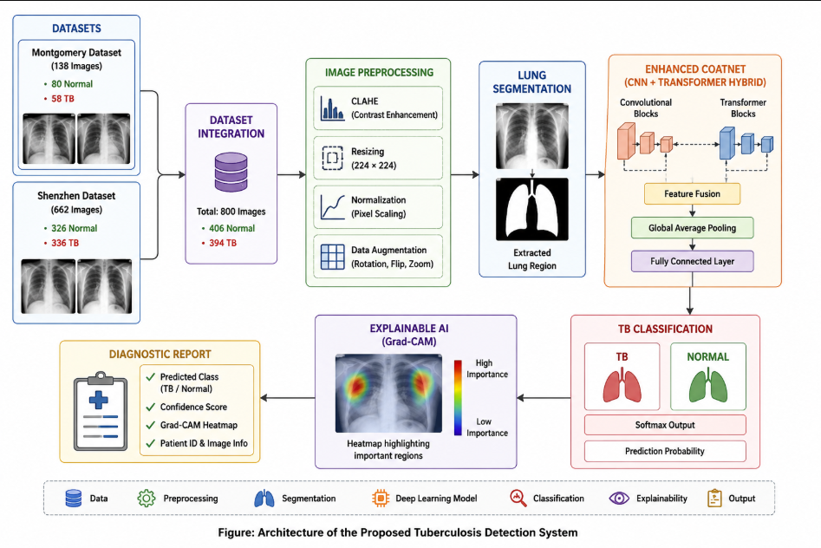
ARCHITECTURE DIAGRAM

Slide 9
PROPOSED WORK WITH PLANNED INNOVATION
Proposed Work
Integrate Montgomery and Shenzhen chest X-ray datasets.
Apply image preprocessing (Resize and CLAHE).
Perform lung segmentation using TorchXRayVision.
Train the Enhanced CoAtNet model for TB classification.
Generate Grad-CAM visualizations.
Produce an automated diagnostic report.
Planned Innovation
Integration of lung segmentation with Enhanced CoAtNet.
Grad-CAM-based explainable AI for visual interpretation.
Improved model interpretability and diagnostic support.
Automated diagnostic report generation.

Slide 10
MODULES OF THE PROJECT
Module 1: Dataset Collection
Collect Shenzhen Chest X-ray Dataset
Collect Montgomery Chest X-ray Dataset
Gather TB and Normal chest X-ray images
Module 2: Dataset Integration
Merge both datasets
Verify image labels (TB/Normal)
Remove duplicate and invalid images
Module 3: Image Preprocessing
Resize images to 224 × 224
Apply CLAHE for contrast enhancement
Prepare images for model training

Slide 11
Module 4: Lung Segmentation
Segment lung regions using TorchXRayVision
Remove background noise
Extract lung Region of Interest (ROI)
Module 5: Enhanced CoAtNet Model
Load pretrained CoAtNet model
Fine-tune using transfer learning
Extract deep features and classify images
Module 6: TB Classification
Predict Tuberculosis or Normal
Generate prediction confidence score

Slide 12
Module 7: Explainable AI (Grad-CAM)
Generate Grad-CAM heatmaps
Visualize important lung regions
Interpret model predictions
Module 8: Diagnostic Report Generation
Display predicted class
Display confidence score
Display Grad-CAM heatmap
Generate final diagnostic report

Slide 13
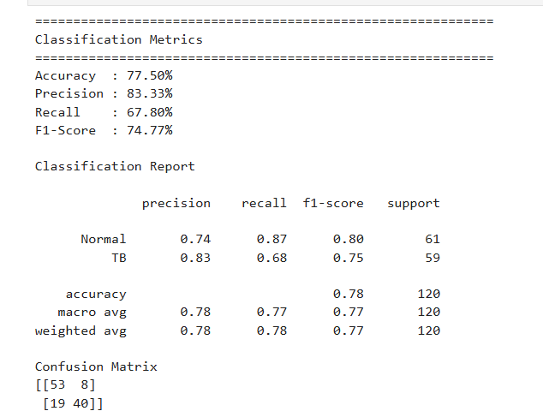
IMPLEMENTATION

Slide 14
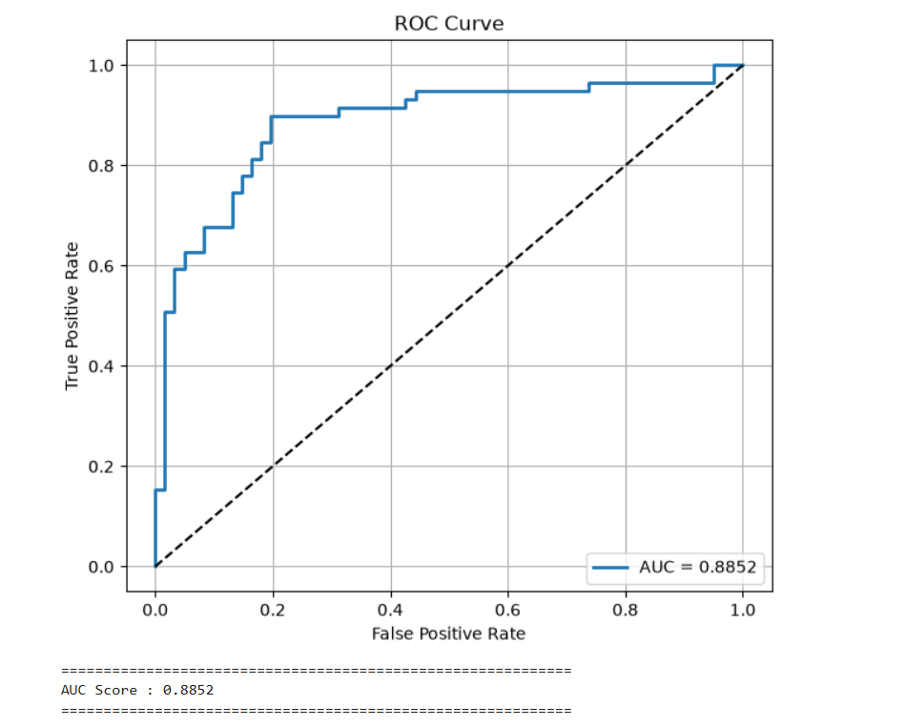

Slide 15
THANK YOU

